Slide 1
Internship Studio’s Ethical Internship Project
By: SHREYA PANDEY
Email: csengineerspandey@gmail.com

Slide 2
TASK -03
ENTERING/SOLVING A GIVEN WEBSITE USING BURPSUITE

Slide 3
Steps to solve the website:
Step 1: Open Oracle VM virtual box and start the virtual machine
Step 2: Then login into Kali linux to your root account

Slide 4
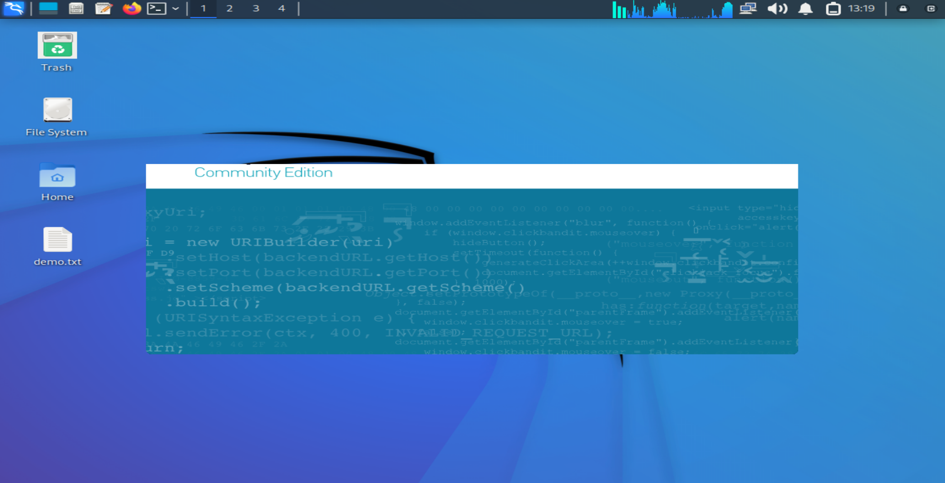
Step 3: Open Burp Suite

Slide 5
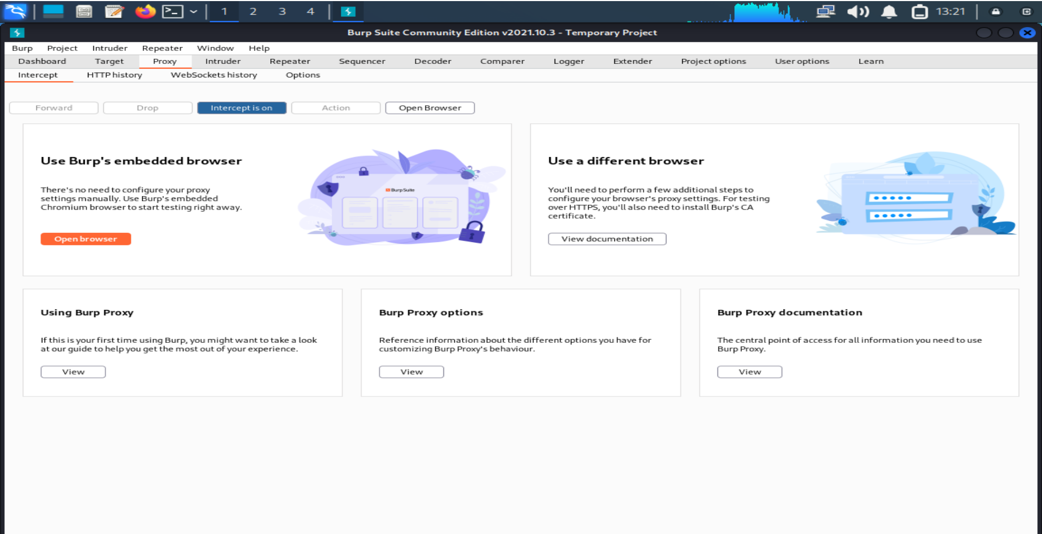
Step 4: Check whether Intercept is on or not

Slide 6
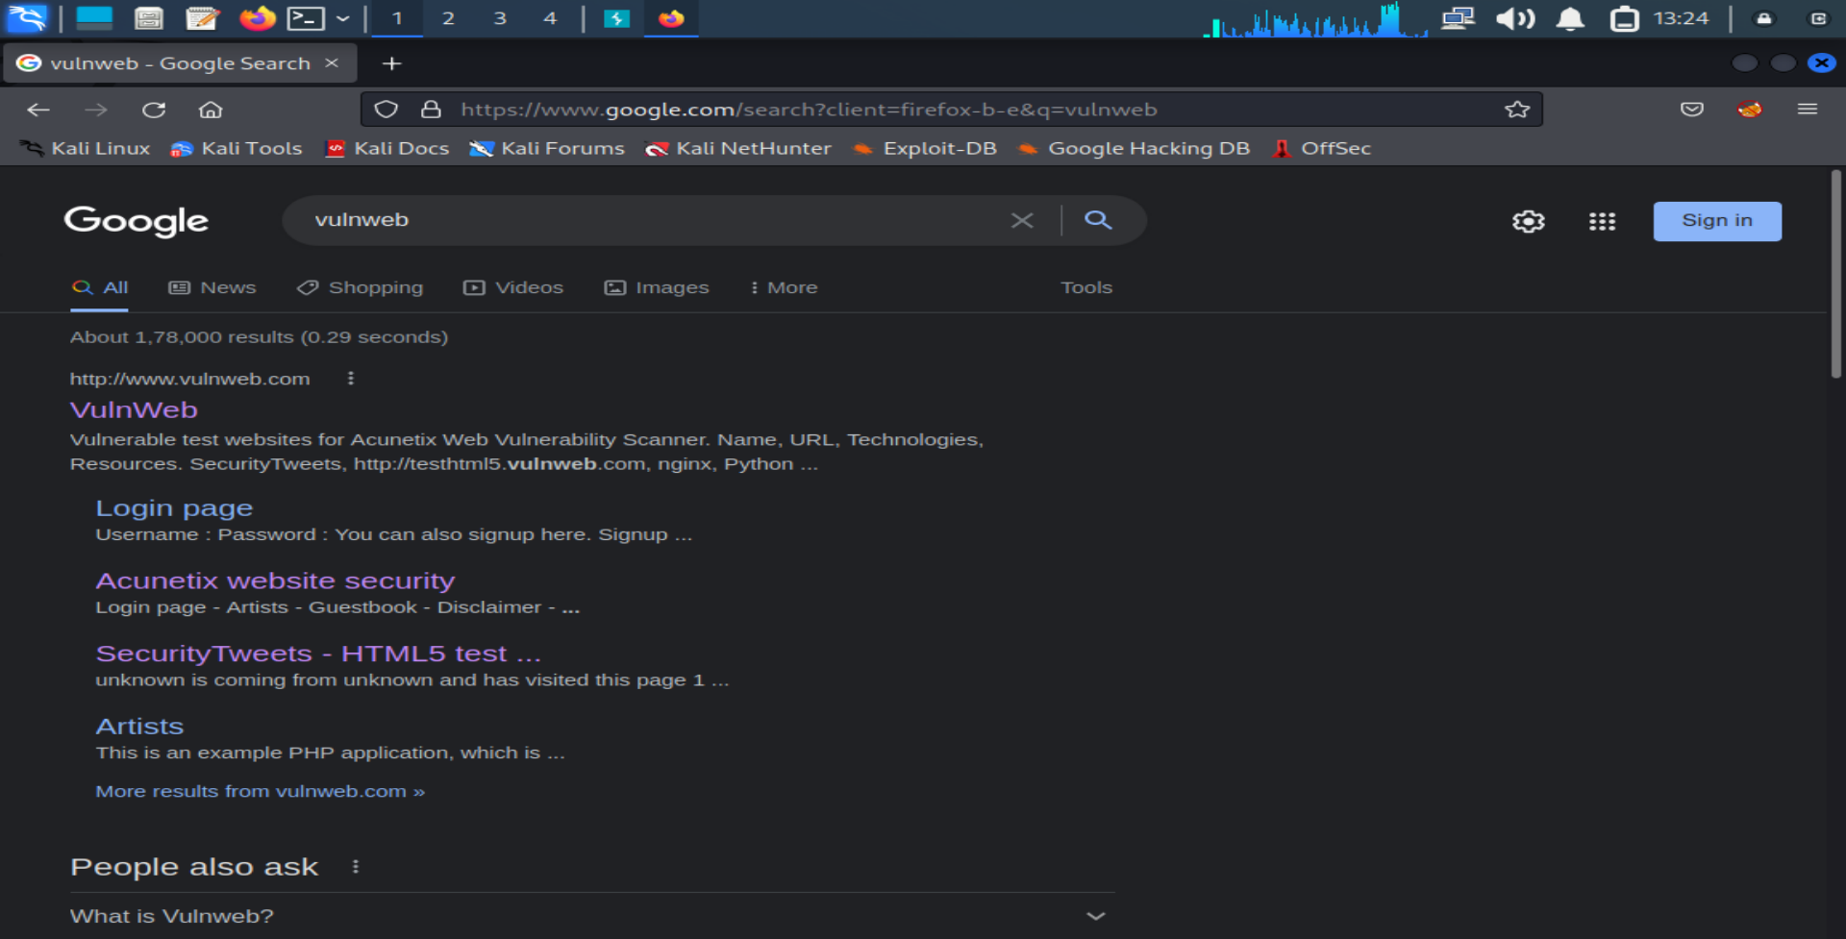
Step 5: Open Mozilla Firefox browser and search “vulnweb”

Slide 7
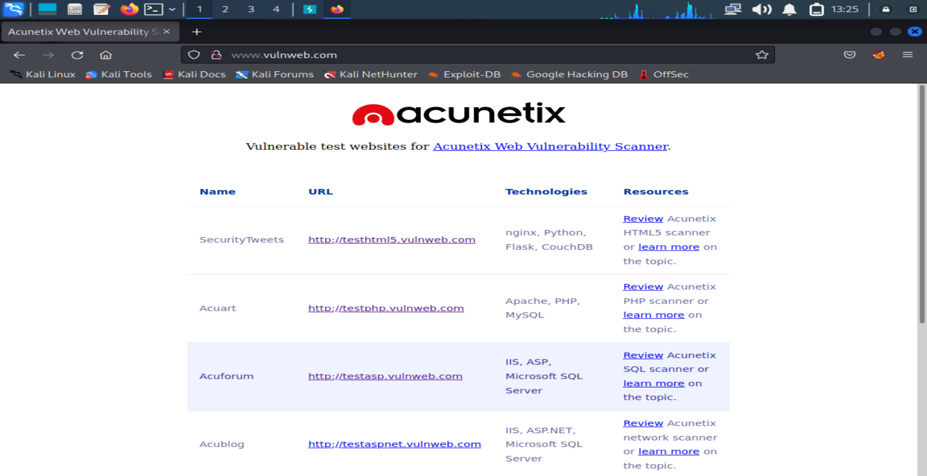
Step 6: Click on http://testasp.vulnweb.com on the given interface

Slide 8
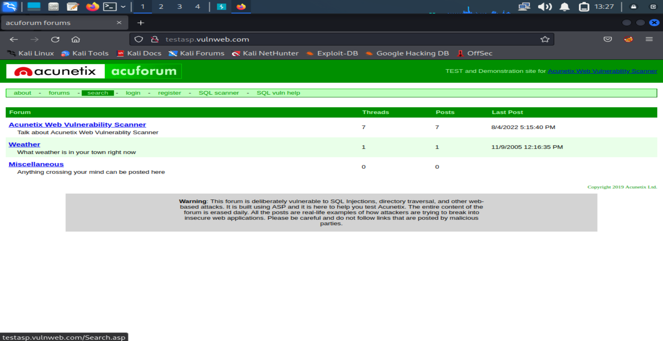
Step 7: Click on the search bar

Slide 9
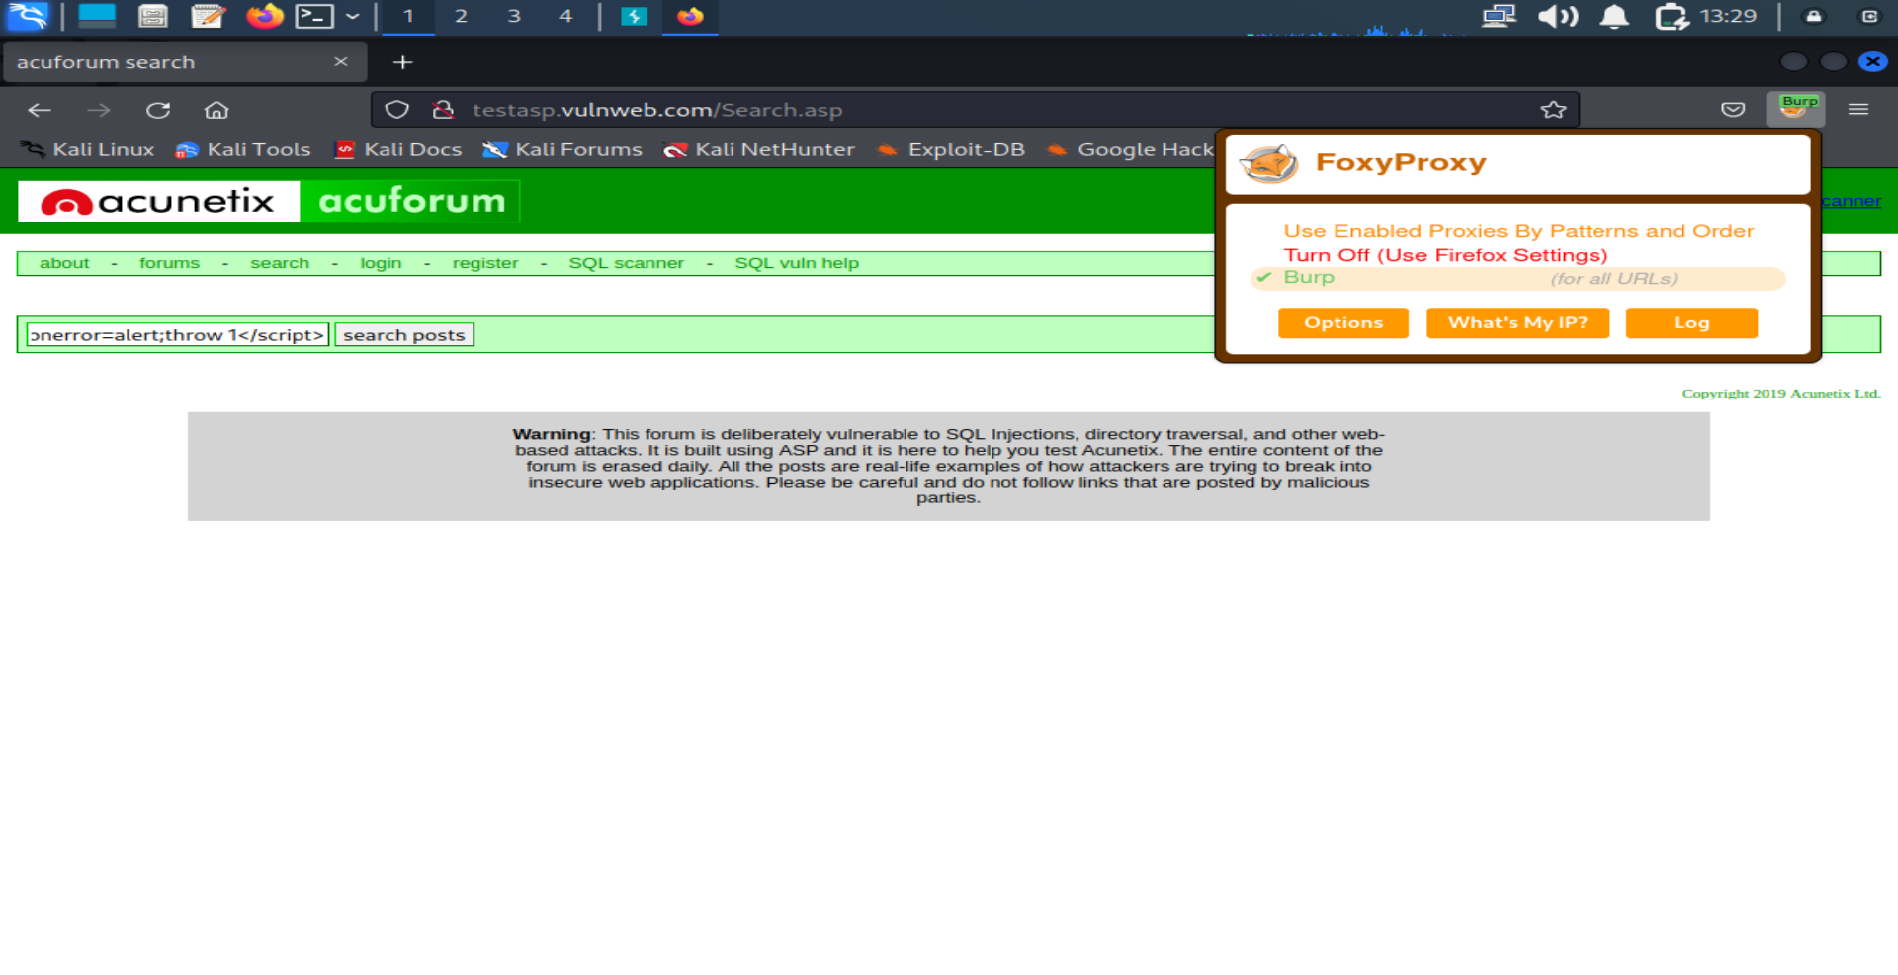
Step 8: Click on FoxyProxy and turn on “Burp” then type <script>onerror=alert; throw 1</script> and search it

Slide 10
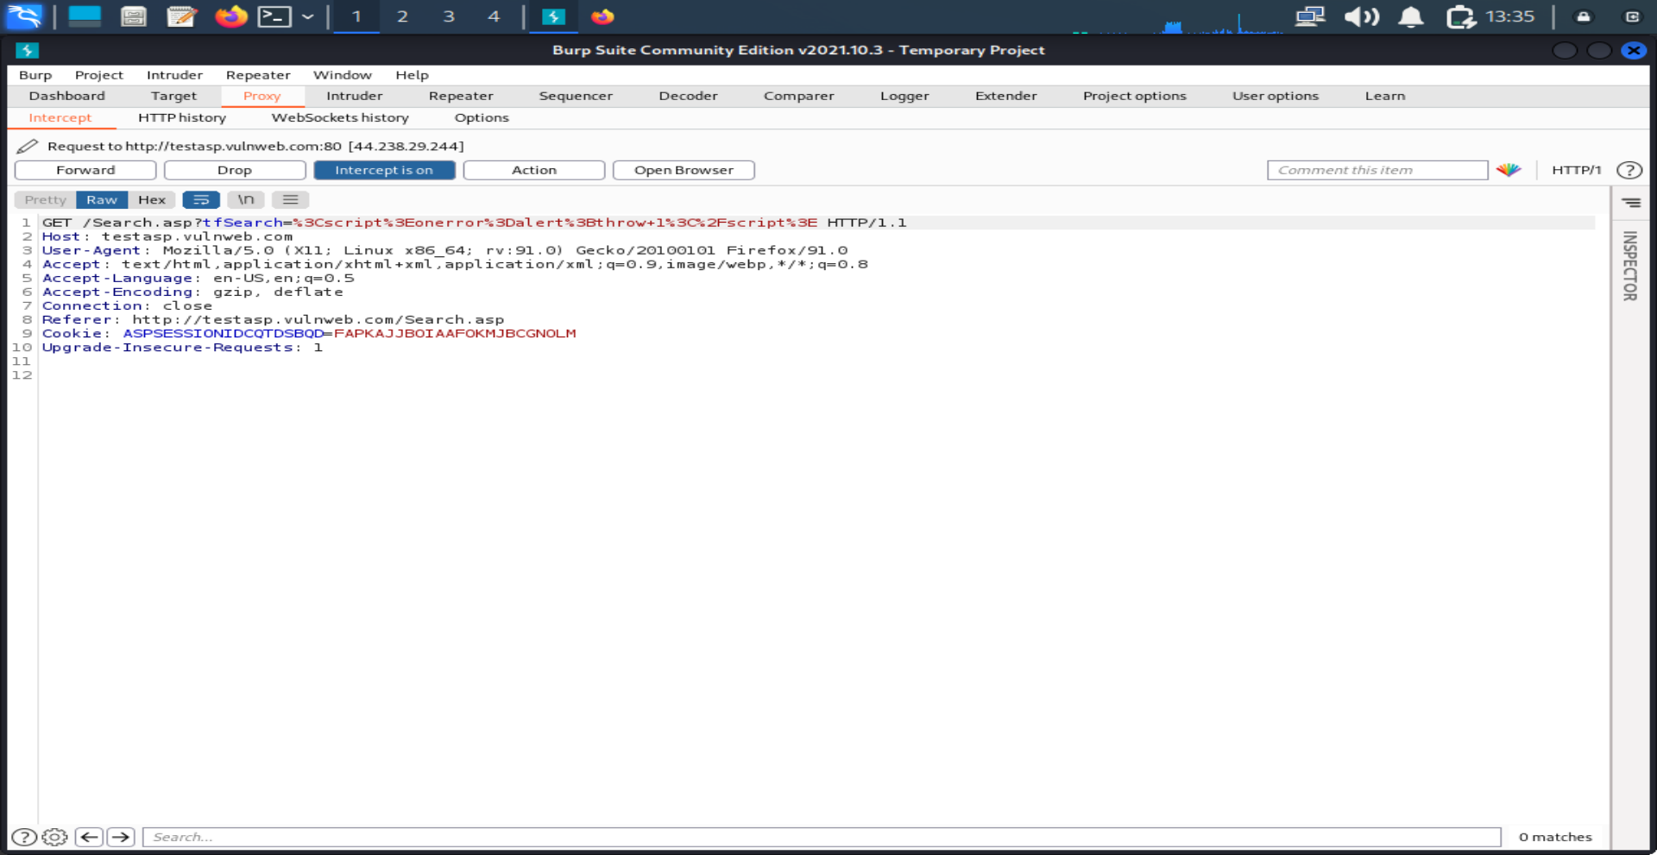
Step 9: After the request is made then firstly send it to the intruder then forward it

Slide 11
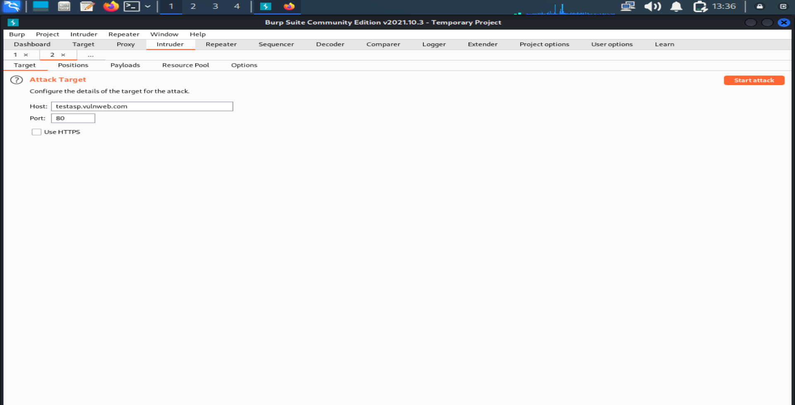
Step 10: Go to the Intruder and check target

Slide 12
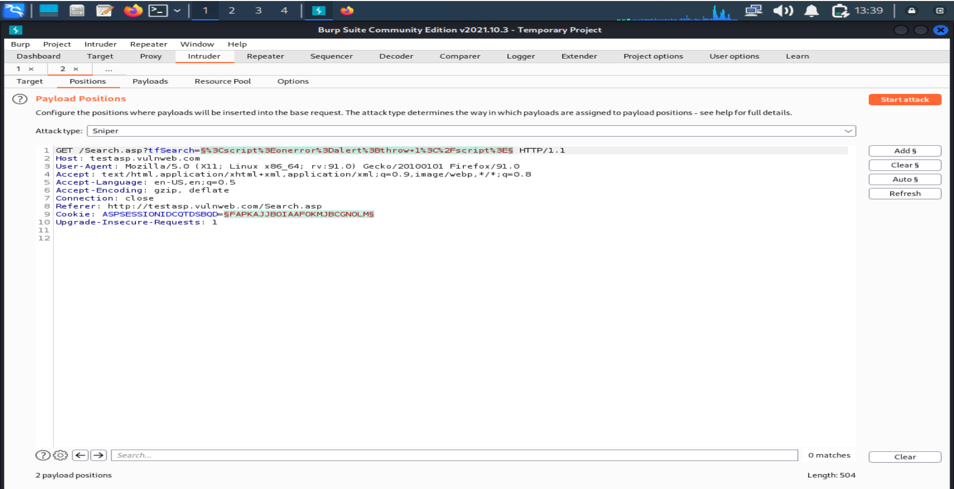
Step 11: Then go to positions in intruder

Slide 13
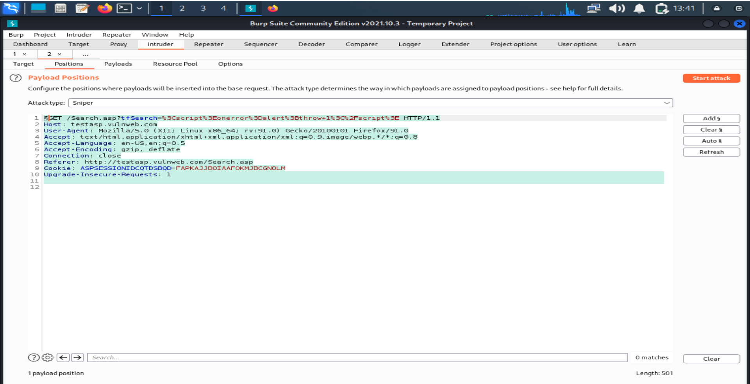
Step 12: Add the payload position for required place

Slide 14
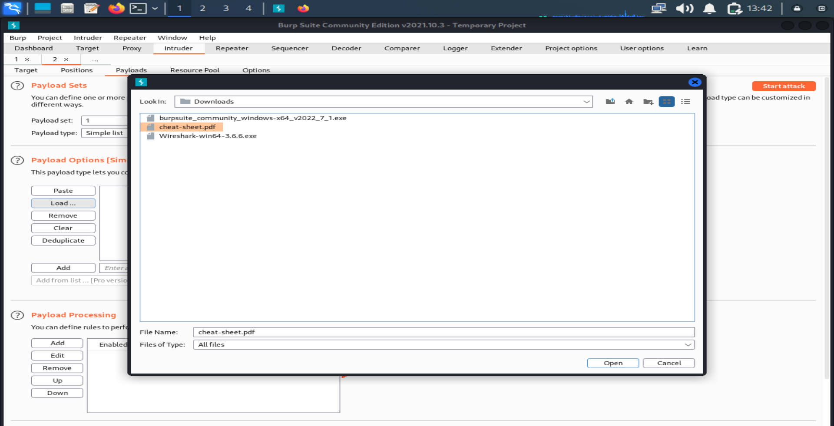
Step 13: Go to the payloads and add the payload from the system

Slide 15
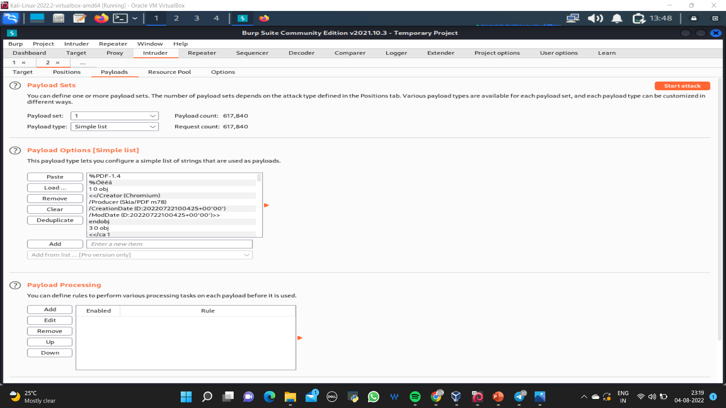
Step 14: After loading the payloads, start the attack

Slide 16
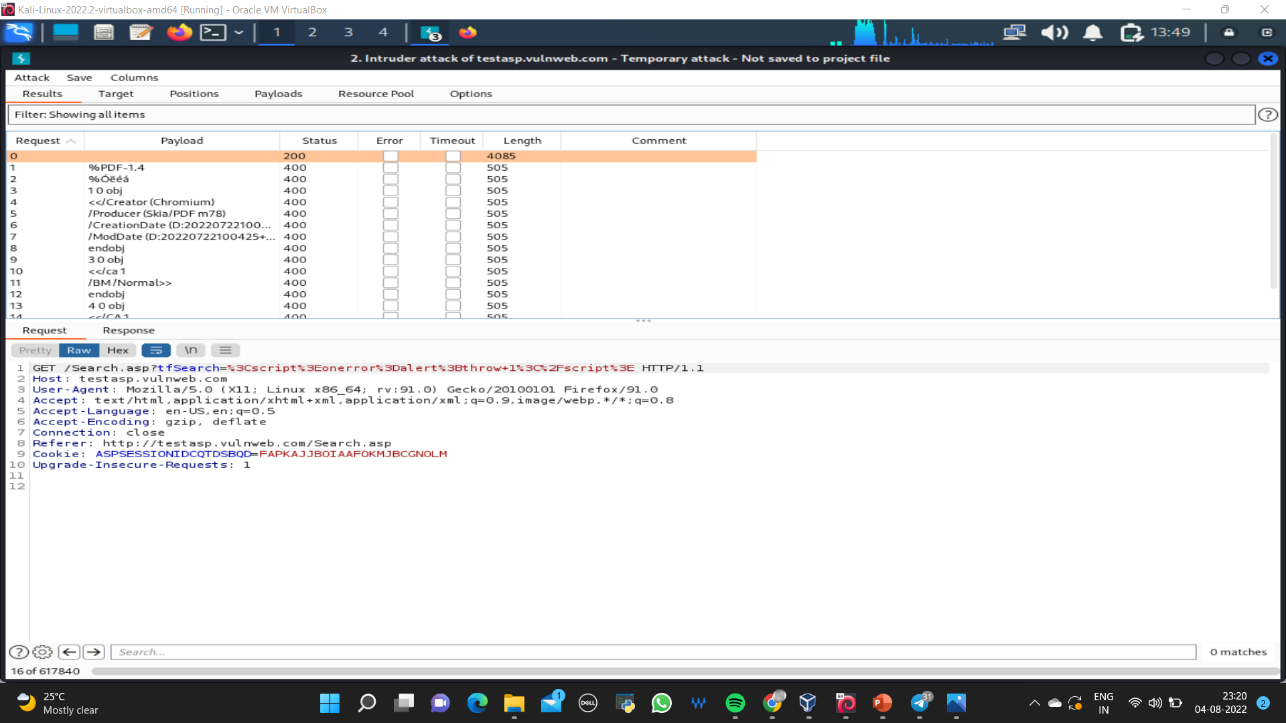
Step 15: Check whether there is a sudden change in length and status

Slide 17
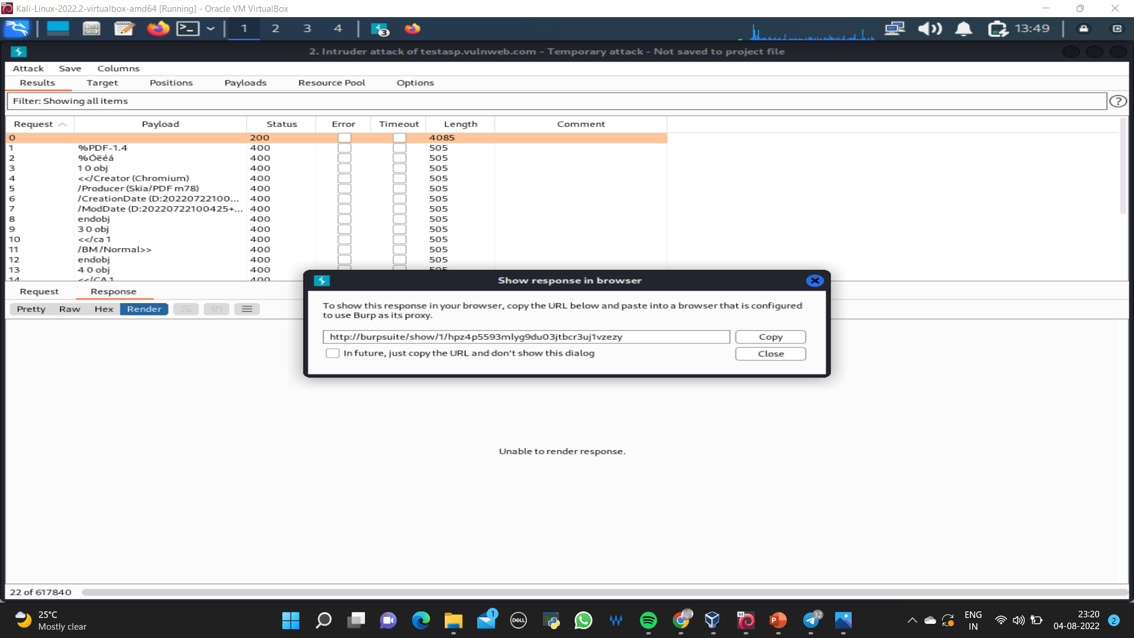
Step 16: Copy the URL to show the response for the payload that has been accepted

Slide 18
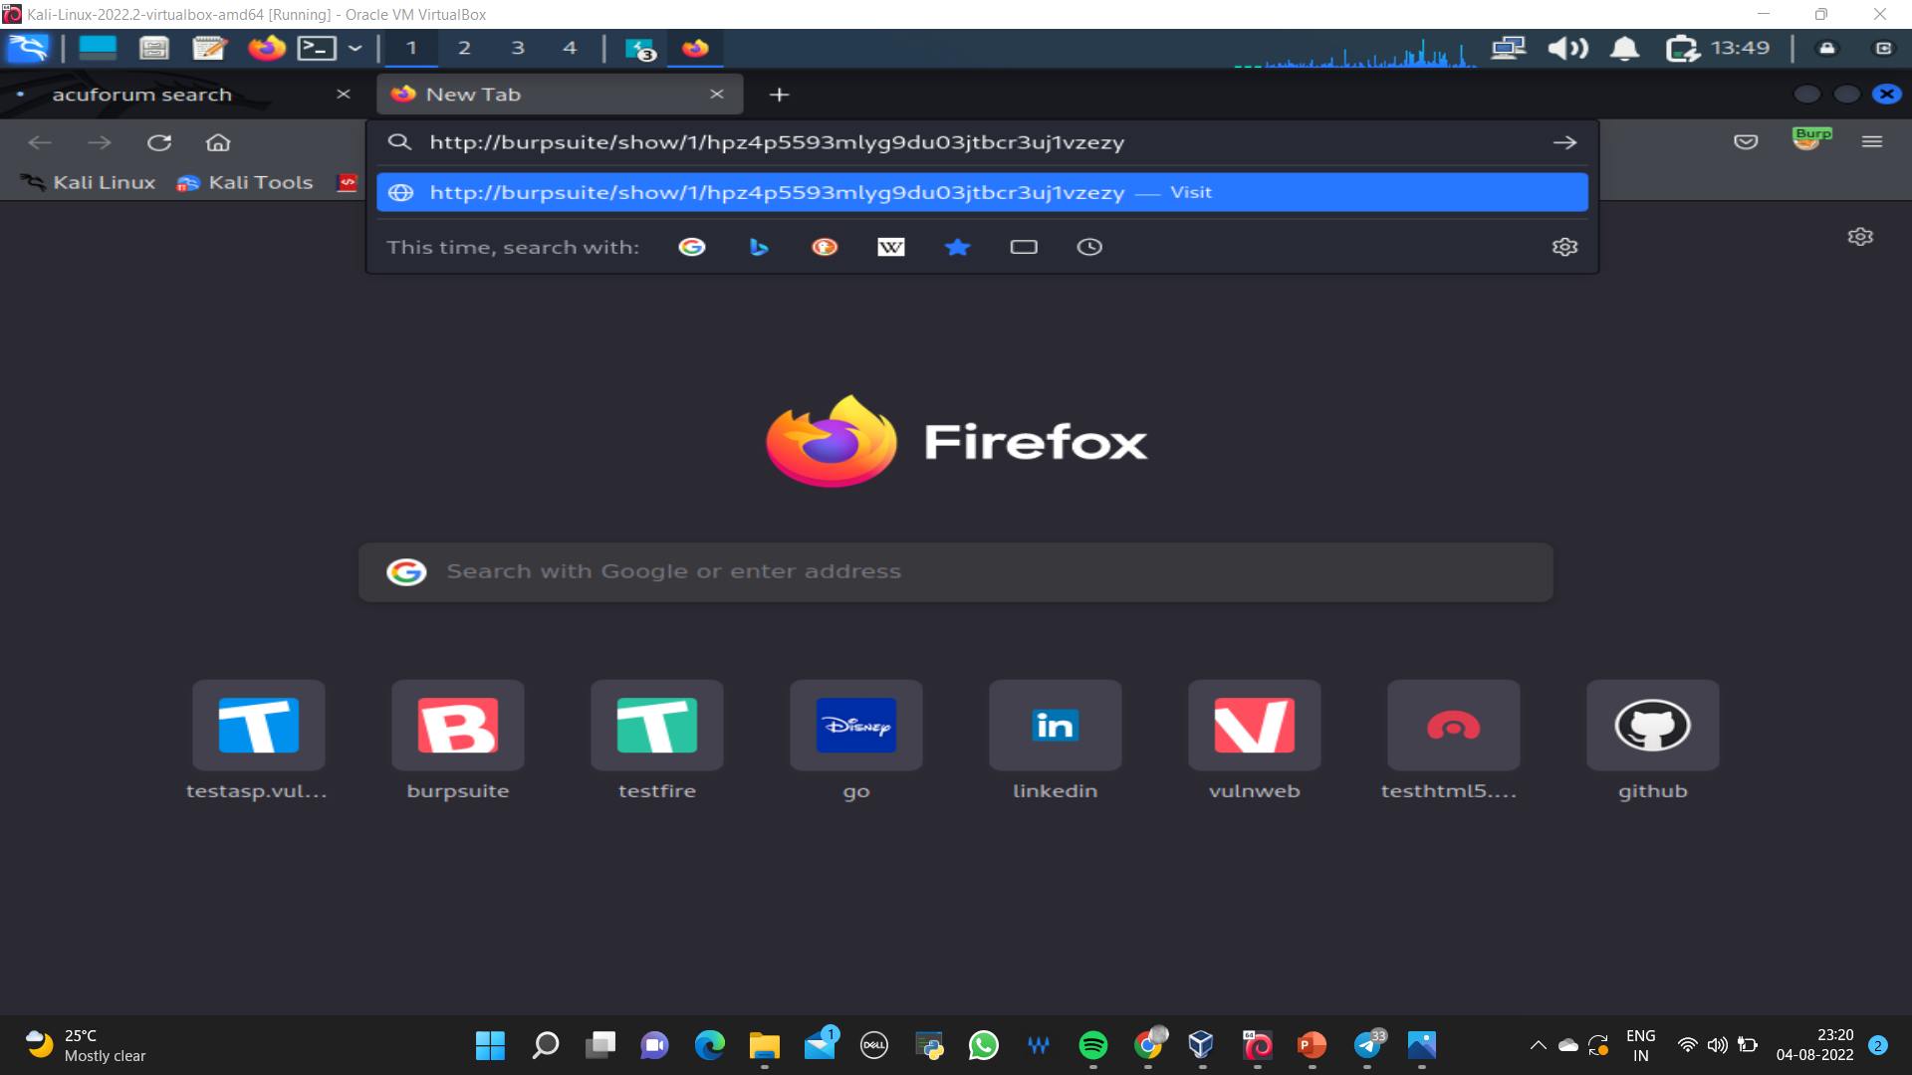
Step 17: Copy the URL and search it in Mozilla Firefox browser

Slide 19
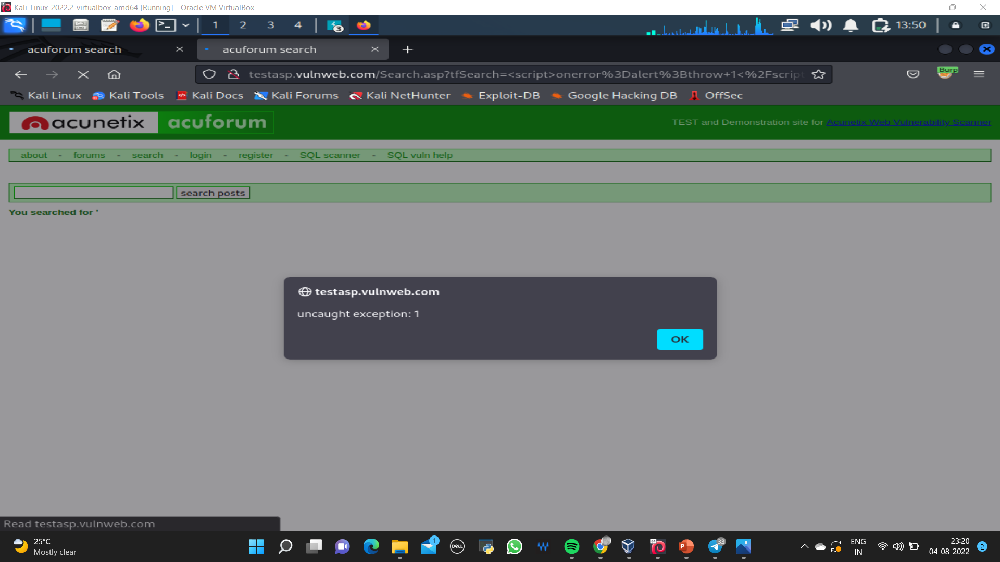
The required interface will be in this format

Slide 20
Thank you!

